Slide 1

CHAPTER 10
THEORY OF GRAPHS AND TREES
Copyright © Cengage Learning. All rights reserved.

Slide 2

10.3
Isomorphisms of Graphs
Copyright © Cengage Learning. All rights reserved.

Slide 3
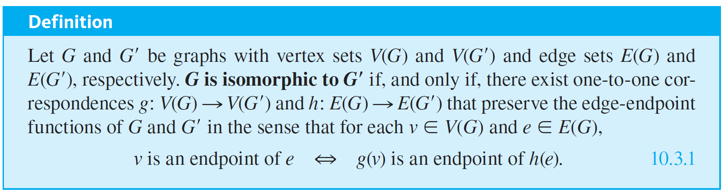
Isomorphisms of Graphs
Two graphs that are the same except for the labeling of their vertices and edges are called isomorphic. The word isomorphism comes from the Greek, meaning “same form.” Isomorphic graphs are those that have essentially the same form.

Slide 4
Isomorphisms of Graphs
In words, G is isomorphic to G′ if, and only if, the vertices and edges of G and G′ can be matched up by one-to-one, onto functions in such a way that the edges between corresponding vertices correspond to each other.

Slide 5
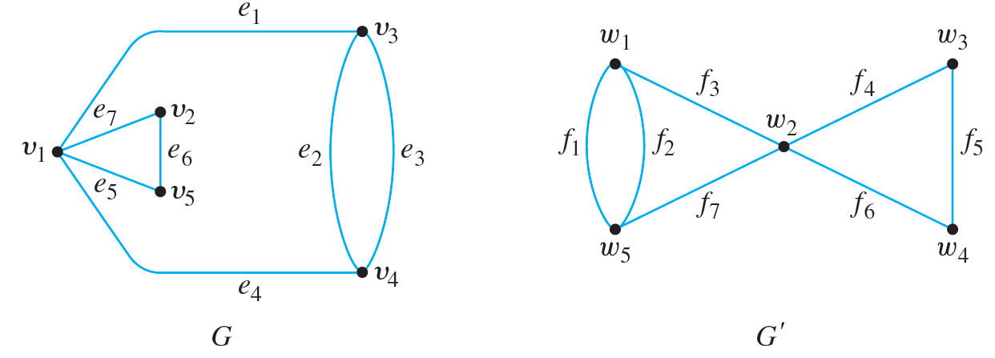
Example 10.3.1 – Showing That Two Graphs Are Isomorphic
Show that the following two graphs are isomorphic.

Slide 6
Example 10.3.1 – Solution
To solve this problem, you must find functions g : V(G) → V(G′) and h: E(G) → E(G′) such that for each v ∈ V(G) and e ∈ E(G), v is an endpoint of e if, and only if, g(v) is an endpoint of h(e).
Setting up such functions is partly a matter of trial and error and partly a matter of deduction.
For instance, since e₂ and e₃ are parallel [have the same endpoints], h(e₂) and h(e₃) must be parallel also.

Slide 7
Example 10.3.1 – Solution
continued
So h(e₂) = f₁ and h(e₃) = f₂ or h(e₂) = f₂ and h(e₃) = f₁. Also, the endpoints of e₂ and e₃ must correspond to the endpoints of f₁ and f₂, and so g(v₃) = w₁ and g(v₄) = w₅ or g(v₃) = w₅ and g(v₄) = w₁.
Similarly, since v₁ is the endpoint of four distinct edges (e₁, e₇, e₅, and e₄), g(v₁) must also be the endpoint of four distinct edges [because every edge incident on g(v₁) is the image under h of an edge incident on v₁ and h is one-to-one and onto].

Slide 8
Example 10.3.1 – Solution
continued
But the only vertex in G′ that has four edges coming out of it is w₂, and so g(v₁) = w₂. Now if g(v₃) = w₁, then since v₁ and v₃ are endpoints of e₁ in G, g(v₁) = w₂ and g(v₃) = w₁ must be endpoints of h(e₁) in G′. This implies that h(e₁) = f₃.
By continuing in this way, possibly making some arbitrary choices as you go, you eventually can find functions g and h to define the isomorphism between G and G′.

Slide 9
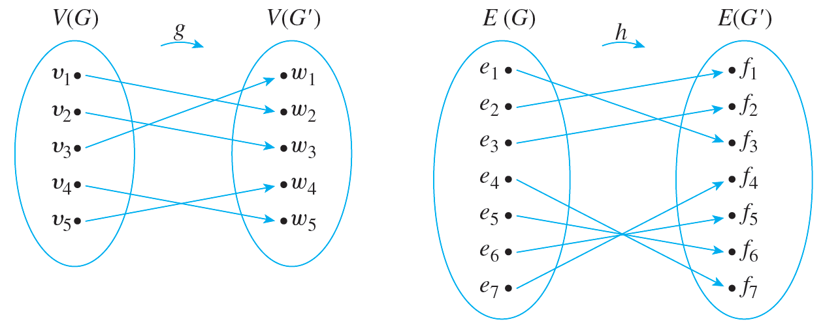
Example 10.3.1 – Solution
continued
One pair of functions (there are several) is the following:

Slide 10
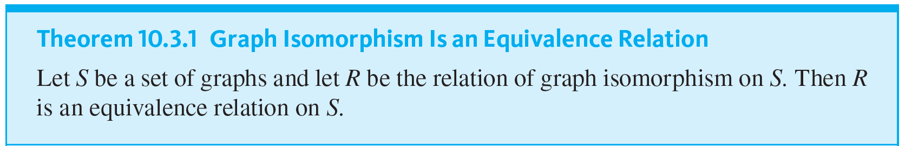
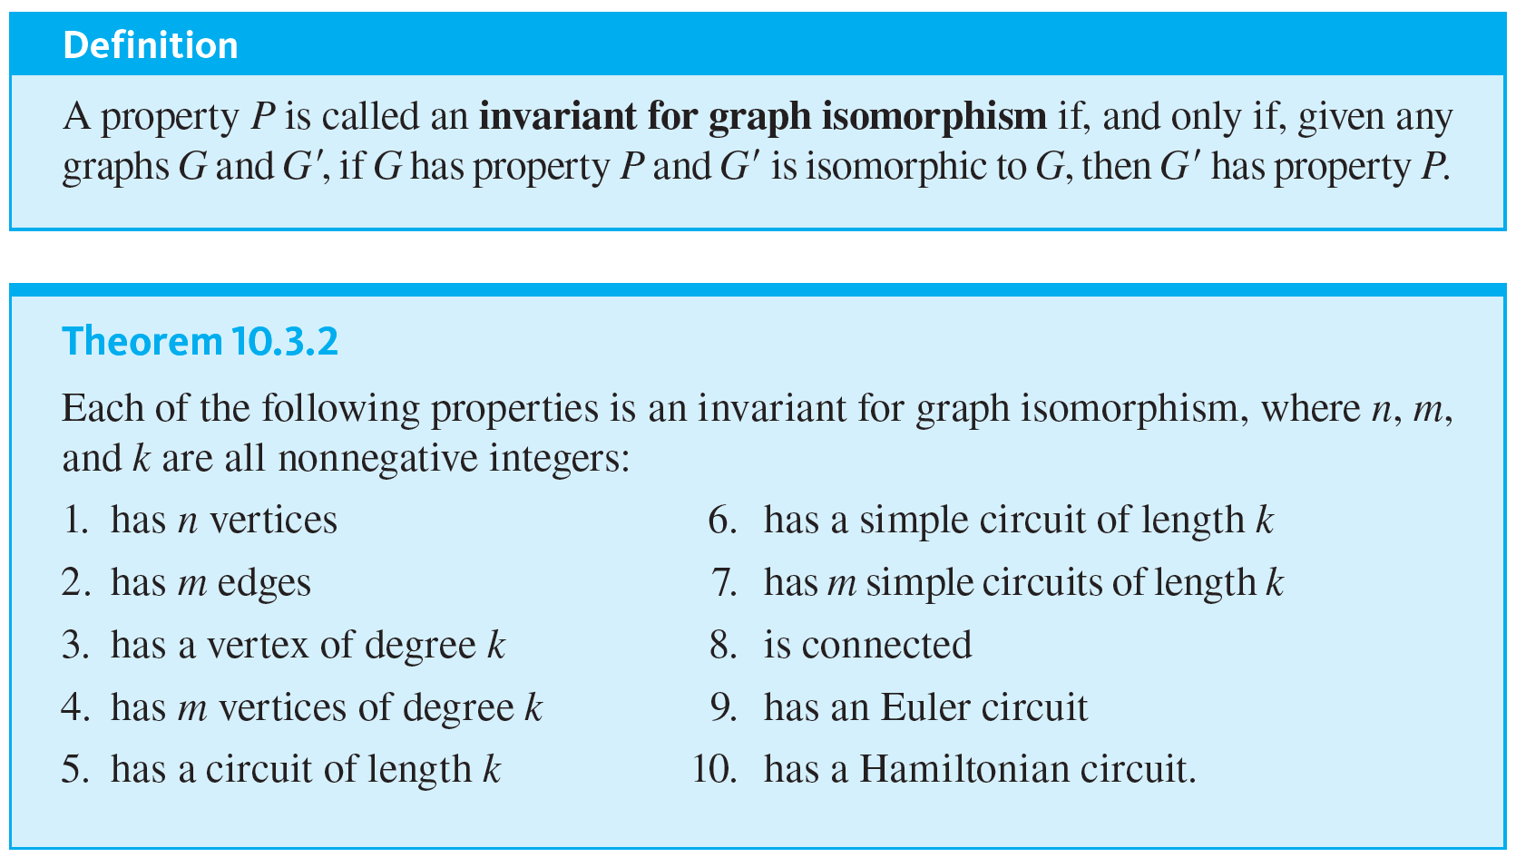
Isomorphisms of Graphs

Slide 11
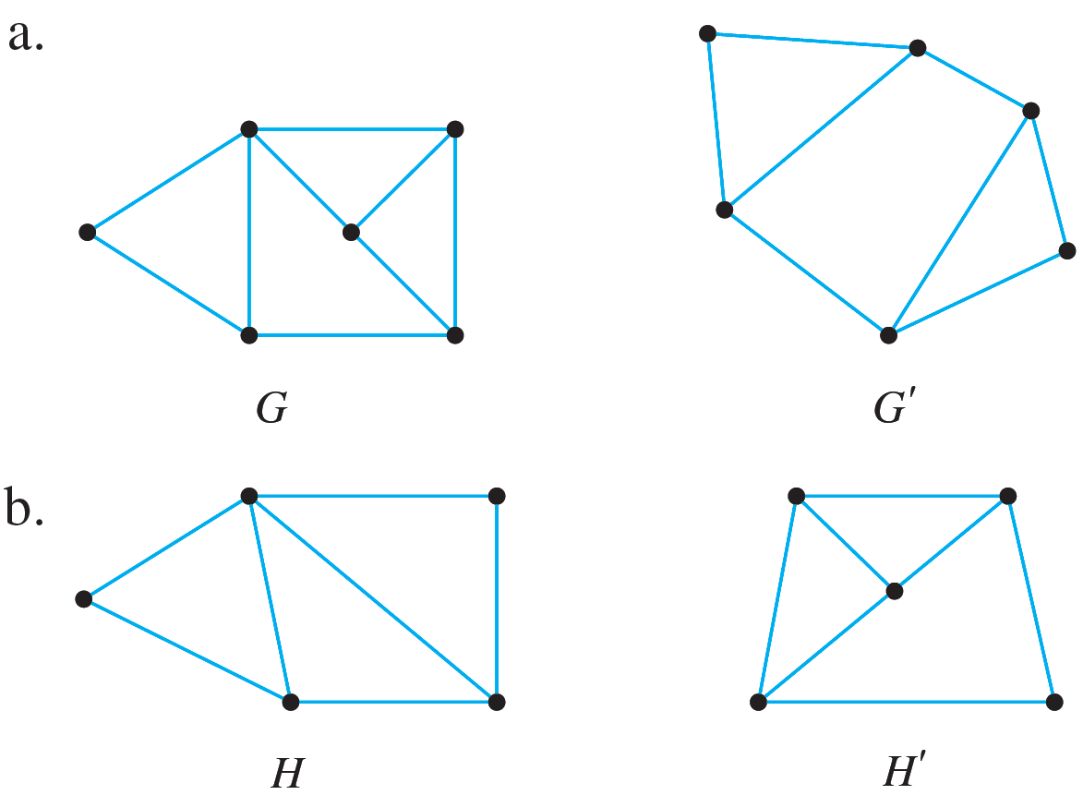
Example 10.3.3 – Showing That Two Graphs Are Not Isomorphic
Show that the following pairs of graphs are not isomorphic by finding an isomorphic invariant that they do not share.

Slide 12
Example 10.3.3 – Solution
a. G has nine edges; G′ has only eight.
b. H has a vertex of degree 4; H′ does not.

Slide 13
Graph Isomorphism for Simple Graphs

Slide 14
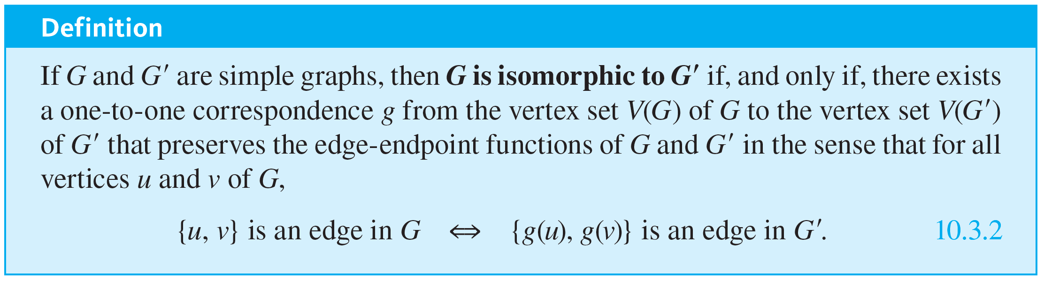
Graph Isomorphism for Simple Graphs
When graphs G and G′ are both simple, the definition of G being isomorphic to G′ can be written without referring to the correspondence between the edges of G and the edges of G′.

Slide 15
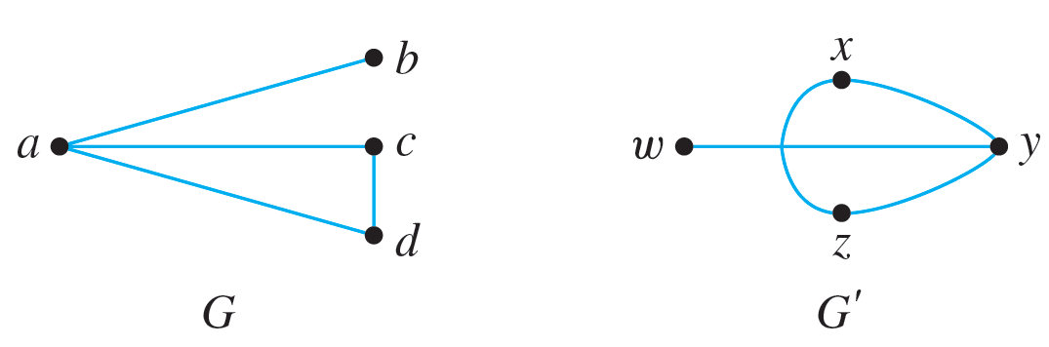
Example 10.3.5 – Isomorphism of Simple Graphs
Are the two graphs shown below isomorphic? If so, define an isomorphism.

Slide 16
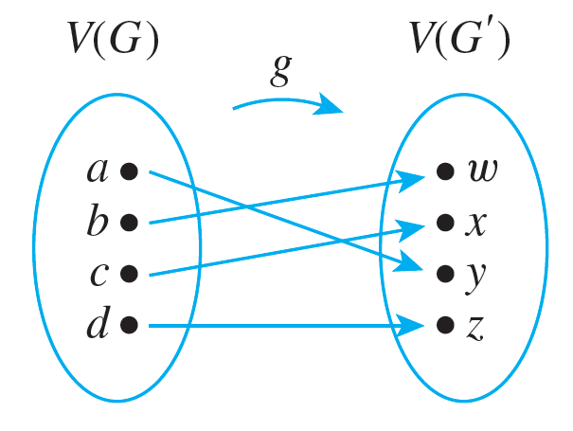
Example 10.3.5 – Solution
Yes. Define g : V(G) → V(G′) by the arrow diagram shown below.
Then g is one-to-one and onto by inspection.

Slide 17
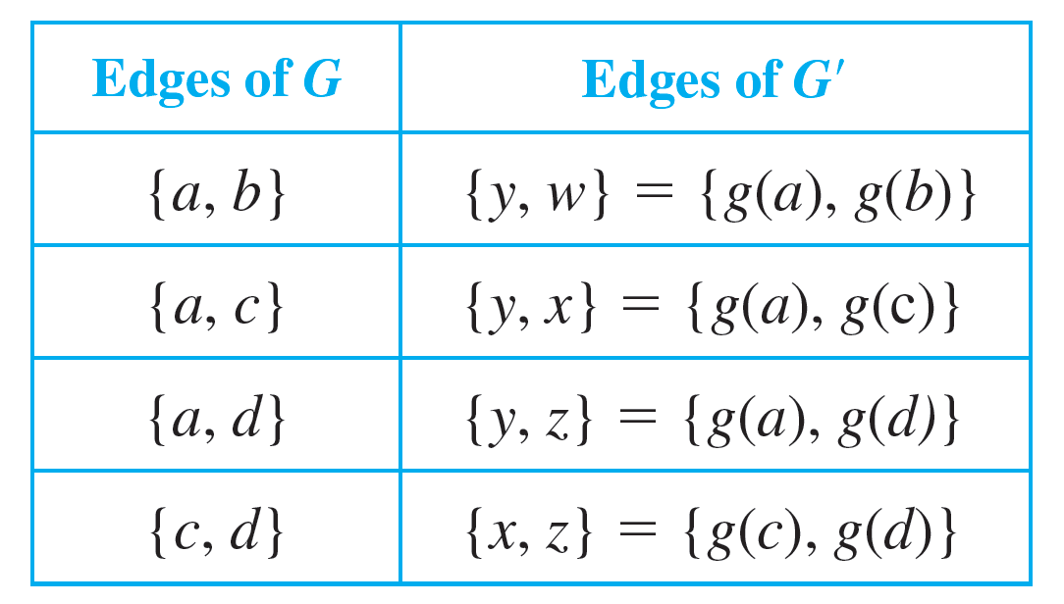
Example 10.3.5 – Solution
continued
The fact that g preserves the edge-endpoint functions of G and G′ is shown by the following table:

